Slide 1
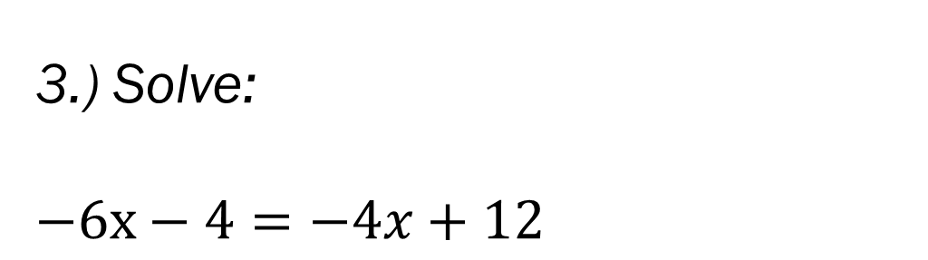

Bell Work
3.) Solve:
$$−6x−4=−4x+12$$
1.) Simplify:
$$−6x−4−4x+12$$
2.) Solve:
$$−6x−4−4x+12=0$$

Slide 2
From Last Time…
From Last Time
Page 37-38 #3-5, 10, 27, 31, 35, 44
Mixed Review
Page 40 #72, 75, 78

Slide 3
ALGEBRA 3
Day 9

Slide 4
From Last Time: 1.5 Solving Inequalities
Linear Inequality: linear equation with inequality symbol
(<, >, ≥, ≤) instead of the equals sign (=)
*Remember you solve inequalities the same way you normally would with an = sign except….
If you have to Multiply or Divide both sides by the same negative number, then you must reverse the inequality.
WHY does this rule exist?!? How else could we solve??

Slide 5
Examples from last time
Solve and Graph the Following:
1.) 5 – 2x ≤ 17
2.) or
3.) 1 ≤ 2x – 5 ≤ 7

Slide 6
Quick Check for Understanding
How would you describe the difference in your solution if there is a
> , < compared to a ≥ , ≤ ? How are inequalities different from equations?
How does your answer change if there are multiple inequalities instead of just one in the problem?
Any questions before the quiz?

Slide 7

Unit 1 Quiz 1: Level 2
1.) Simplify 2.) Solve for x
$6a+4b−6b+6a+10$ $5x−11>29$
3.) Solve for w $4.) Solve for a$
$\frac{3w}{4}+7=16$ $4d=ab−c$

Slide 8
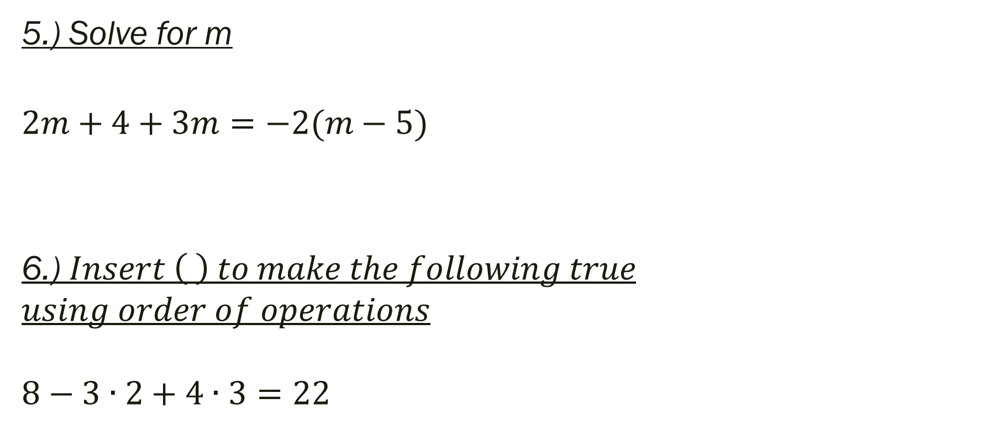
Unit 1 Quiz 1: Level 3
5.) Solve for m
$$2m+4+3m=−2(m−5)$$
6.) $Insert \left( \right) to make the following true$
$$using order of operations$$
$$8−3∙2+4∙3=22$$

Slide 9
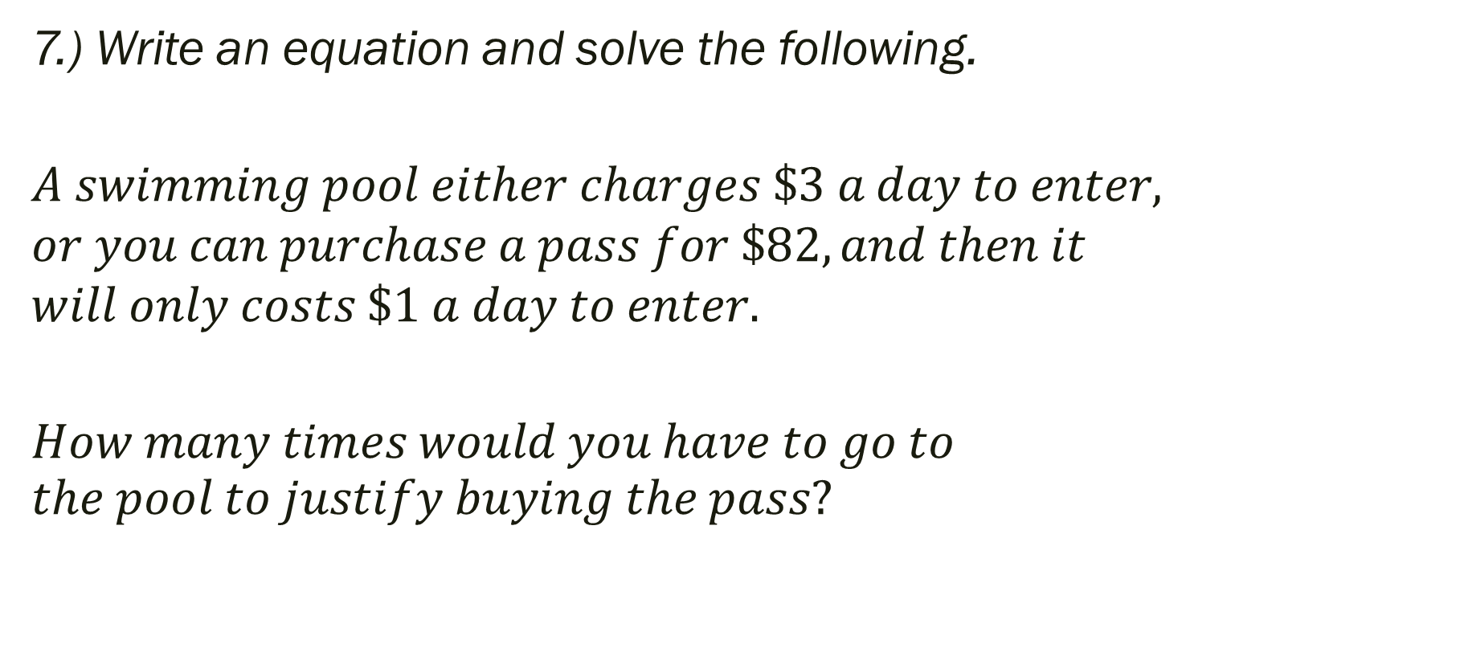
Unit 1 Quiz 1: Level 4
7.) Write an equation and solve the following.
$$A swimming pool either charges \$3 a day to enter,$$
$$or you can purchase a pass for \$82, and then it$$
$$will only costs \$1 a day to enter.$$
$$How many times would you have to go to \\ the pool to justify buying the pass?$$

Slide 10
For Next Time…
Page 53 #1, 6, 8, 11, 13,
15, 17, 19, 20, 22, 25

